Slide 1
Introduction to Random Forest

Slide 2
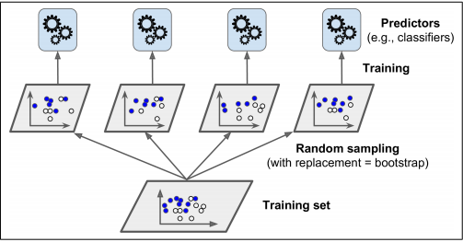
Issue with Bagging
Average the results from high variance and low bias models
Trees are more correlated.

Slide 3
Random Forest
we select random samples and random features on which we want to train our Machine Learning model.
This will help trees to be more de-correlated because we cannot estimate the initial split of a decision tree
How to choose these random sets of features?
d = floor(sqrt(D)) , for classification problem
d = floor(D/3) , for regression problem

Slide 4
Random Forest
Here 'D' is the total number of features and 'd' is the random set of features to be selected
If D < 15 , max_features = 0.5 ,
else If D > 40 -> Inventors recommendation

Slide 5
Pseudo Algorithm
Suppose we have a dataset of ‘N’ samples and ‘D’ features
Draw a sample with replacement each of size ‘S’.
create a new model and fit the model to the current sample
repeat step-1 , 2 B times and keep collecting all trained models
Aggregate all models while doing prediction (same as bagging)

